Slide 1

Big Data Vision & Strategy for the Ebrahim K Kanoo Group

Slide 2
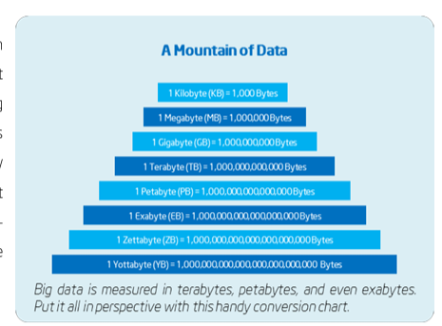
Big Data Vision for Ebrahim K Kanoo Group
A vision for Big Data From Kanoo Groups perspective, Big Data is an unprecedented opportunity for innovation, growth and job creation. Understanding the potential whilst identifying challenges is essential to delineate policies that encourage take-up of Big Data analytics by the public and private sectors and protect the interests of all involved.
Big Data refers to huge data sets that are orders of magnitude larger (volume); more diverse, including structured, semi-structured and unstructured data (variety) and arriving faster (velocity) than any organization has had to deal with before. This flood of data is generated by connected devices –from PCs and smart phones to sensors such as RFID readers ,barcode IOT devices ,security system, fire alarms, GPS and traffic cams. Plus, it is heterogeneous and comes in many formats, including text, document, image, video, and more.

Slide 3
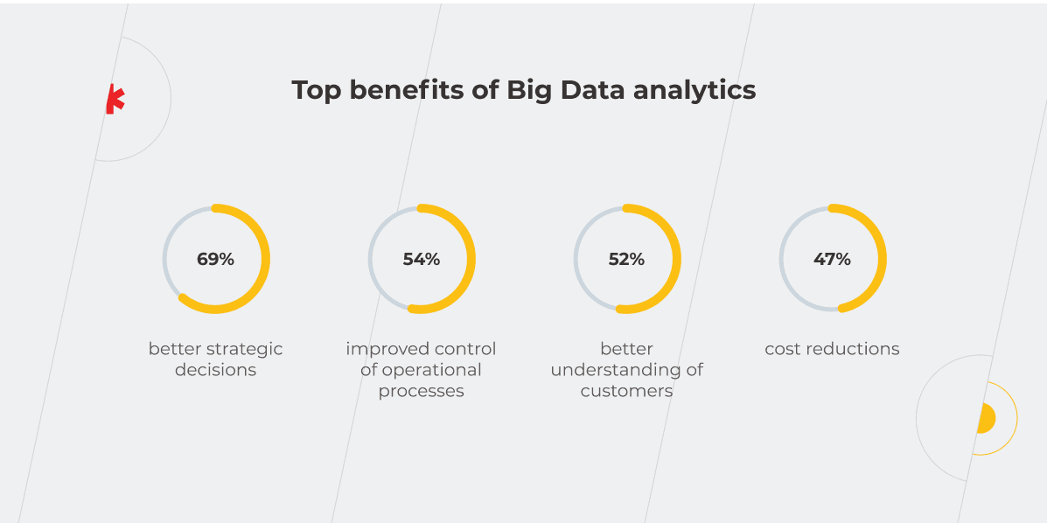
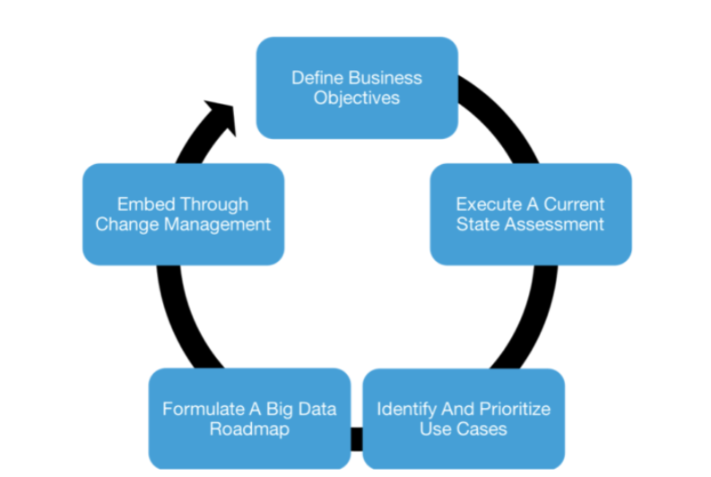
As Big Data is designed to deliver value by leveraging data, the Big Data strategy needs to tackle key business problems and contribute to the corporate business goals. Here are the initiatives where Big Data can be applied: Understanding customer persona Prediction of sales Analysis of data from different sources Identification of financial risks Pinpointing of fraud activities or logs Tracking of feedback on socials, customer loyalty, Ecomm marketing metrics Identification of correlations between many independent data sources
A Big Data strategy defines and lays out a comprehensive vision across the enterprise and sets a foundation for the organization to employ data-related or data-dependent capabilities. A well-defined and comprehensive Big Data strategy makes the benefits or Big Data actionable for the organization. It sets out the steps that an organization should execute in order to become a “Data Driven Enterprise”. The Big Data strategy incorporates some guiding principles to accomplish the data-driven vision, directs the organization to select specific business goals and is the starting point for data driven planning across the enterprise.
Formulate a Big Data Strategy for Ebrahim K Kanoo Group
Define business objectives
Execute a current state assessment
Identify and prioritize Use Cases
Formulate a Big Data Roadmap
Embed through Change Management

Slide 4
Recommended approach on development and delivery of big data program for Ebrahim K Kanoo Group

Slide 5
Introduction Real-life big data implementation steps may vary greatly depending on the business goals a solution is to meet, data processing specifics (e.g., real-time, batch processing, both), etc. However, from My experience, there are five universal steps that are likely to be present in most projects. Step 1. Feasibility study Analyzing business specifics and needs, validating the feasibility of a big data solution, calculating the estimated cost and ROI for the implementation project, assessing the operating costs. Step 2. Requirements engineering and big data solution planning Defining the types of data (e.g., SaaS data, SCM records, operational data, images and video) to be collected and stored, the estimated data volume, and the required data quality metrics. ▪ Forming a high-level vision of the solution, outlining: ▪ Data processing specifics (batch, real-time, or both). ▪ Required storage capabilities (data availability, data retention period, etc.). ▪ Integrations with the existing IT infrastructure components (if applicable). ▪ The number of potential users. ▪ Security and compliance (e.g., HIPAA, PCI DSS, GDPR) requirements. ▪ Analytics processes to be introduced to the solution (e.g., data mining, ML-based predictive analytics). ▪ Choosing a deployment model: on-premises vs. cloud (public or private) vs. hybrid. ▪ Selecting an optimal technology stack. ▪ Preparing a comprehensive project plan with timeframes, required talents, and budget outlined. Step 3. Architecture design Creating the data models that represent all data objects to be stored in big data databases, as well as associations between them, to get a clear picture of data flows, the ways data of certain formats will be collected, stored, and processed in the solution-to-be. ▪ Mapping out data quality management strategy and data security mechanisms (data encryption, user access control, redundancy, etc.). ▪ Designing the optimal big data architecture that enables data ingestion, processing, storage, and analytics.

Slide 6
Step 4. Big data solution development and testing ▪ Setting up the environments for development and delivery automation (CI/CD pipelines, container orchestration, etc.). ▪ Building the required big data components (e.g., ETL pipelines, a data lake, a DWH) or the entire solution using the selected techs. ▪ Implementing data security measures. ▪ Performing quality assurance in parallel with development. Conducting comprehensive testing of the big data solution, including functional, performance, security and compliance testing. Step 5. Big data solution deployment Preparing the target computing environment and moving the big data solution to production. ▪ Setting up the required security controls (audit logs, intrusion prevention system, etc.). ▪ Launching data ingestion from the data sources, verifying the data quality (consistency, accuracy, completeness, etc.) within the deployed solution. ▪ Running system testing to validate that the entire big data solution works as expected in the target IT infrastructure. ▪ Selecting and configuring big data solution monitoring tools, setting alerts for the issues that require immediate attention (e.g., server failures, data inconsistencies, overloaded message queue).

Slide 7
Data Governance for Ebrahim K Kanoo Group

Slide 8
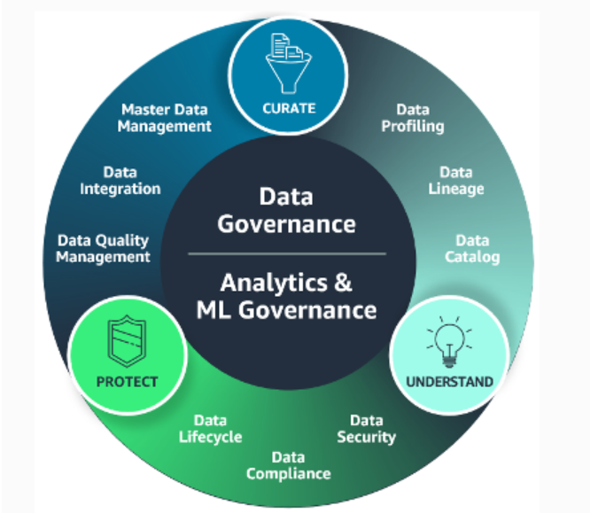
What are the AWS offerings for data governance? With end-to-end data governance on AWS, organizations have control over where their data sits, who has access to it, and what can be done with it at every step of the data workflow. Data governance with AWS helps organizations accelerate data-driven decisions by making it easy for the right people and applications to securely and safely find, access, and share the right data when they need it. You can curate data by automating data integration and data quality to limit the proliferation of data. You can discover and understand your data with centralized catalogs that boost data literacy. You can protect your data with precise permissions that let you share data with confidence. You can reduce risk and improve regulatory compliance by monitoring and auditing data access. Amazon DataZone – unlock data across organizational boundaries with built-in governance AWS Glue – discover, prepare, and integrate all your data at any scale AWS Lake Formation – centrally govern, secure, and share data for analytics and machine learning Amazon QuickSight unified business intelligence at hyperscale Amazon SageMaker – build, train, and deploy machine learning models for use cases with fully managed infrastructure, tools, and workflows ML governance web page Amazon Bedrock – build and scale generative AI applications with foundation models (FMs) Amazon Macie - discover and protect sensitive data at scale Amazon Simple Storage Service (Amazon S3) access points – object storage built to retrieve any amount of data from anywhere AWS Data Exchange – easily find, subscribe to, and use third-party data in the cloud AWS Clean Rooms – create clean rooms in minutes to collaborate with your partners without sharing raw data

Slide 9
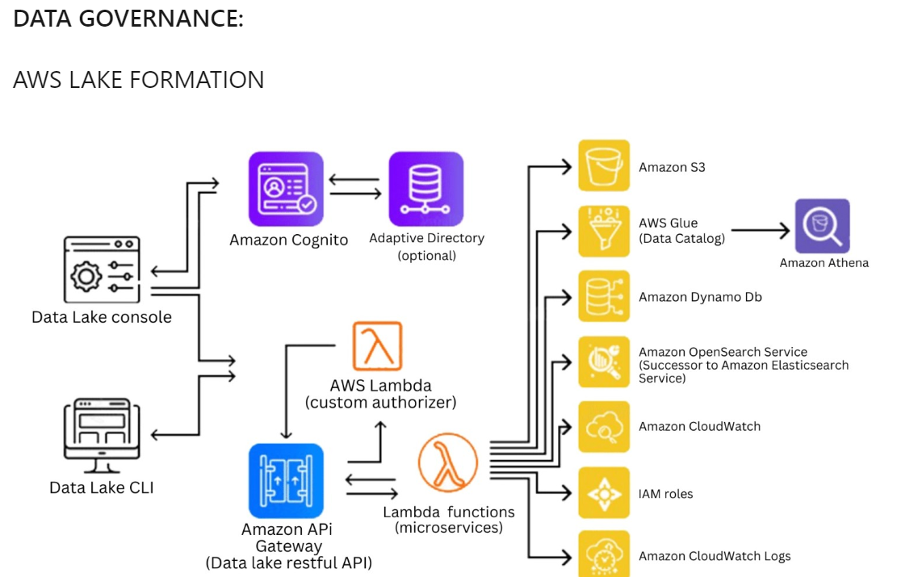
Data Governance Architecture

Slide 10
AWS Lake Formation is a fully managed service provided by Amazon Web Services (AWS) that simplifies the process of building, securing, and managing data lakes. A data lake is a centralized repository that allows you to store structured and unstructured data at any scale, enabling various analytics and data processing capabilities. Here are the key features and capabilities of AWS Lake Formation: Data Lake Creation: AWS Lake Formation makes it easy to set up a secure and scalable data lake on AWS. It provides a simplified interface to define and configure the data lake structure, including data ingestion, storage, and access policies. Data Ingestion: Lake Formation enables you to ingest data from various sources into your data lake. It supports data ingestion from services like Amazon S3, Amazon RDS, Amazon Redshift, and more. You can schedule periodic data updates and configure data ingestion pipelines. Data Cataloging and Organization: Lake Formation includes a data catalog that serves as a central repository for metadata management. It allows you to organize and categorize data assets, define data schemas, and maintain a unified view of your data across different sources. Data Access Control and Security: Lake Formation provides fine-grained access control to your data lake. You can define and enforce data access policies at the table or column level, ensuring that only authorized users and applications can access and modify the data. It integrates with AWS Identity and Access Management (IAM) for user and group management. Data Transformation and Processing: AWS Lake Formation integrates with AWS Glue, which enables you to perform data transformations and processing tasks. You can use Glue's ETL (Extract, Transform, Load) capabilities to clean, transform, and prepare data for analysis and other downstream applications. Data Governance and Compliance: Lake Formation helps you establish data governance practices and enforce compliance standards. You can define data quality rules, implement data retention policies, and track data lineage to ensure data traceability and compliance with regulatory requirements. Integration with Analytics Services: Lake Formation seamlessly integrates with AWS analytics services like Amazon Athena, Amazon Redshift Spectrum, and Amazon QuickSight. You can query and analyze data stored in your data lake using SQL queries, build interactive dashboards, and gain insights from your data. Monitoring and Auditing: Lake Formation provides monitoring and auditing capabilities to track data access and changes. It integrates with AWS CloudTrail and AWS CloudWatch to capture logs and metrics, enabling you to monitor the health and usage of your data lake. AWS Lake Formation simplifies the process of setting up and managing a data lake on AWS, allowing organizations to leverage the benefits of a centralized and scalable data repository. It provides robust security and access control features, enabling data governance and compliance. With integration to various AWS analytics services, Lake Formation empowers users to derive meaningful insights from their data lake.

Slide 11
Target AWS Architecture Overview including end to end data flow

Slide 12
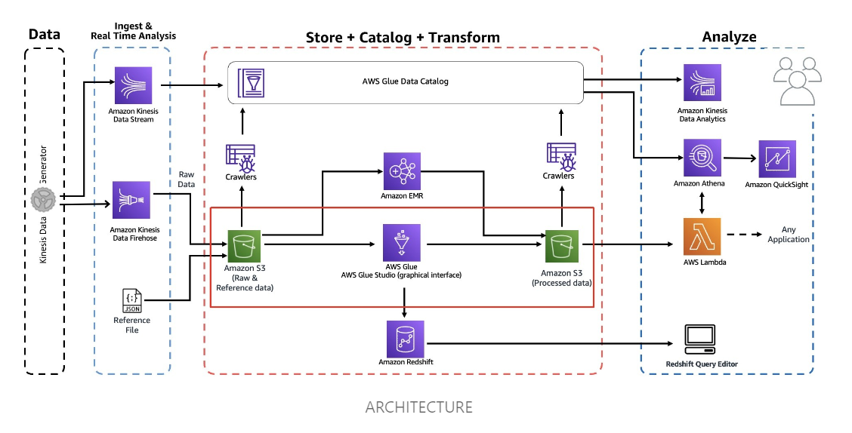

Slide 13
Data architecture refers to the overall design and structure of an organization's data ecosystem, including data storage, processing, analytics, and governance. AWS provides a wide range of services that can be leveraged to build a comprehensive data architecture. Here's an overview of AWS services related to each aspect of data architecture: Data Storage: Amazon S3 (Simple Storage Service): A scalable object storage service for storing and retrieving any amount of data. Amazon EBS (Elastic Block Store): Provides persistent block-level storage volumes for use with EC2 instances. Amazon EFS (Elastic File System): A fully managed file system that can be shared across multiple EC2 instances. Data Processing: AWS Glue: A fully managed extract, transform, and load (ETL) service that makes it easy to prepare and transform data for analytics. Amazon EMR (Elastic MapReduce): A managed big data platform that simplifies the processing of large amounts of data using frameworks like Apache Spark and Hadoop. AWS Batch: Enables batch processing of large amounts of data with automatic resource provisioning and management. Data Analytics: Amazon Redshift: A fully managed data warehousing service for analyzing large datasets with high performance and scalability. Amazon Athena: Allows you to query data stored in Amazon S3 using standard SQL without the need for infrastructure setup or management. Amazon QuickSight: A cloud-native business intelligence service for creating interactive dashboards and visualizations. Data Governance: AWS Lake Formation: Simplifies the process of building and managing data lakes, providing capabilities for data access control, data cataloging, and data transformation. AWS Glue DataBrew: Helps to clean and normalize data for analytics, ensuring data quality and compliance. AWS Glue Data Catalog: A metadata repository that stores metadata about data sources, transformations, and targets. By combining AWS services, organizations can design and implement a robust and scalable data architecture that meets their storage, processing, analytics, and governance requirements. The specific services used will depend on the organization's needs, data volume, complexity, and desired outcomes.

Slide 14
AWS capabilities with data platform core components

Slide 15
AMAZON EMR Amazon EMR (Elastic MapReduce) is a fully managed big data processing service provided by Amazon Web Services (AWS). It simplifies the deployment and management of big data frameworks, such as Apache Hadoop, Apache Spark, and Presto, for processing and analyzing large amounts of data. Here are the key features and capabilities of Amazon EMR: Easy Cluster Management: Amazon EMR allows you to easily create and manage Hadoop, Spark, and other big data clusters with a few clicks or through the AWS Management Console. It automatically handles the provisioning, configuration, and scaling of cluster resources. Scalability and Flexibility: EMR enables you to scale your clusters up or down to handle varying workloads. You can add or remove nodes dynamically based on your processing needs. EMR also supports spot instances, allowing you to take advantage of cost savings by utilizing spare AWS capacity. Broad Range of Applications: EMR supports a wide range of popular big data processing frameworks, including Apache Spark, Apache Hadoop, Presto, Hive, HBase, Flink, and more. You can choose the appropriate framework based on your specific use cases and requirements. Integration with AWS Services: EMR seamlessly integrates with other AWS services, such as Amazon S3 for data storage, Amazon Redshift for data warehousing, AWS Glue for data cataloging, AWS Data Pipeline for data movement, and Amazon QuickSight for business intelligence and analytics. Data Security and Encryption: EMR provides several security features to protect your data. It supports encryption at rest and in transit, integrates with AWS Identity and Access Management (IAM) for fine-grained access control, and enables you to use AWS Key Management Service (KMS) for encryption key management. Cost Optimization: With EMR, you only pay for the resources and duration you use. It offers on-demand and spot instance pricing options to optimize costs. Additionally, EMR supports automatic resizing of clusters based on resource utilization to optimize cost and performance. Integration with Ecosystem Tools: EMR integrates with a rich ecosystem of tools and libraries, including Apache Zeppelin, Jupyter Notebooks, Hue, and more. These tools enhance the development, debugging, and visualization capabilities of your big data workflows. Monitoring and Logging: EMR provides detailed monitoring and logging capabilities. You can monitor cluster performance metrics, track job progress, and access logs for debugging and troubleshooting. EMR integrates with AWS CloudTrail and AWS CloudWatch for centralized monitoring and management.

Slide 16
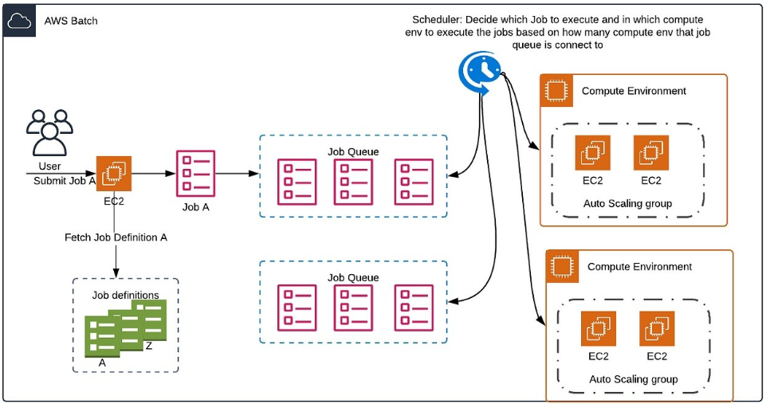
AWS Batch is a fully managed service provided by Amazon Web Services (AWS) that enables you to run batch computing workloads on the cloud. It simplifies the process of provisioning and managing the infrastructure required for batch processing, allowing you to focus on your job execution logic.

Slide 17
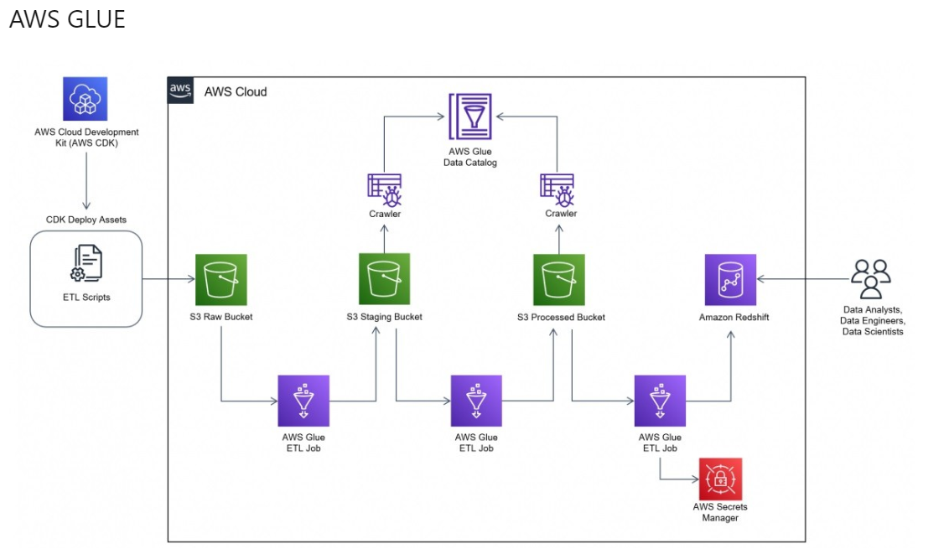
AWS Glue is a fully managed extract, transform, and load (ETL) service provided by Amazon Web Services (AWS). It makes it easy to prepare and transform data for analytics, machine learning, and other data processing tasks. AWS Glue simplifies the process of building and managing data pipelines to ingest, clean, transform, and load data into various data stores and services

Slide 18
AWS Glue: AWS Glue simplifies and accelerates the process of data preparation and transformation, making it easier to build scalable and reliable data pipelines. It enables organizations to leverage their data assets for analytics, machine learning, and other data-driven initiatives. Here are the key features and capabilities of AWS Glue: Data Catalog: AWS Glue includes a centralized metadata repository called the AWS Glue Data Catalog. It stores metadata information about data sources, tables, and partitions, making it easy to discover, search, and query the available data assets. ETL Jobs: AWS Glue enables you to define and execute ETL jobs to extract data from various sources, transform it based on business rules and requirements, and load it into target destinations. You can visually design ETL workflows using a graphical interface or write custom code using Python or Scala. Data Crawling and Discovery: AWS Glue can automatically discover the schema and structure of your data sources, such as Amazon S3, Amazon RDS, Amazon Redshift, and more. It crawls the data sources, infers the schema, and creates metadata tables in the AWS Glue Data Catalog. Data Transformation and Mapping: AWS Glue provides built-in transformations and mapping capabilities to clean, normalize, and transform data during the ETL process. It supports various transformation operations like filtering, aggregation, joining, and data type conversions. Serverless Execution: AWS Glue offers serverless execution, where the infrastructure resources are automatically provisioned and scaled based on the workload. This eliminates the need for manual infrastructure management and ensures high availability and scalability. Integration with Other AWS Services: AWS Glue seamlessly integrates with other AWS services. For example, you can use AWS Glue with Amazon Athena or Amazon Redshift Spectrum to query and analyze data stored in Amazon S3 using SQL. It also integrates with AWS Lambda for serverless data processing and AWS Step Functions for workflow orchestration. Data Quality and Data Lineage: AWS Glue provides data quality features like data deduplication, data validation, and data profiling. It also captures and tracks data lineage information, allowing you to understand the origin and flow of your data. Data Security and Access Control: AWS Glue integrates with AWS Identity and Access Management (IAM) for fine-grained access control to data and resources. You can define IAM roles and policies to control who can access and modify the data pipelines and the AWS Glue Data Catalog.

Slide 19
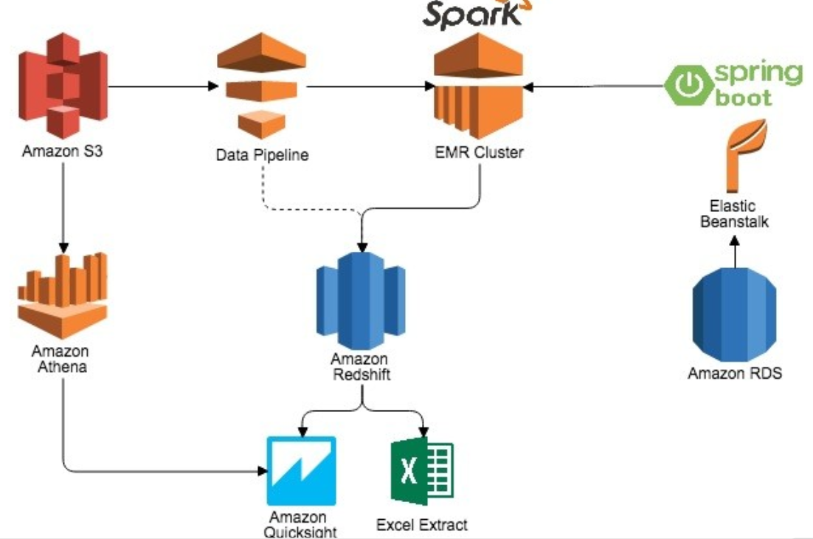
Amazon Redshift is a fully managed, petabyte-scale data warehousing service provided by Amazon Web Services (AWS). It is designed to handle large volumes of data and provide high-performance analytics for data warehousing and business intelligence use cases

Slide 20
Amazon Redshift Amazon Redshift is commonly used for data warehousing, business intelligence, data analytics, and reporting. Its scalability, performance, and integration with other AWS services make it a powerful solution for analyzing large datasets and deriving insights from them. Here are the key features and capabilities of Amazon Redshift: Columnar Storage: Redshift uses a columnar storage format, which enables efficient compression and high-performance querying. It stores and processes data column-wise rather than row-wise, optimizing query execution for analytical workloads. Massively Parallel Processing (MPP): Redshift distributes data and query execution across multiple nodes in a cluster. This parallel processing architecture allows for fast query performance, even with large datasets. Scalability and Elasticity: Redshift enables you to scale your cluster up or down based on your needs. You can add or remove nodes to handle increases or decreases in data volume or query workload. This elasticity allows you to optimize costs by scaling resources as required. Automatic Compression and Data Management: Redshift automatically applies compression techniques to reduce storage requirements and improve query performance. It also manages data distribution and sorts data on disk to enhance query performance. Integration with Data Loading: Redshift supports various methods for loading data into the cluster, including bulk data loading, data streaming, and direct querying of data in Amazon S3. It also integrates with other AWS services like AWS Glue for data cataloging and AWS Data Pipeline for data movement. Security and Encryption: Redshift provides several security features, including encryption at rest using AWS Key Management Service (KMS) for data stored in Redshift, as well as encryption in transit. It also offers features like IAM-based access control, VPC integration, and data masking. Integration with Business Intelligence Tools: Redshift integrates with popular business intelligence (BI) tools like Tableau, Power BI, and Amazon QuickSight. You can connect these tools to Redshift and perform ad-hoc queries, create visualizations, and generate reports. Management and Monitoring: Redshift provides management and monitoring capabilities through the AWS Management Console, command-line interface (CLI), and APIs. You can monitor cluster performance, track query execution, and set up alerts for specific metrics. Cost-Effectiveness: Redshift offers a pricing model based on the size and number of nodes in your cluster. It provides on-demand and reserved instance options, allowing you to optimize costs based on your usage patterns and requirements.

Slide 21
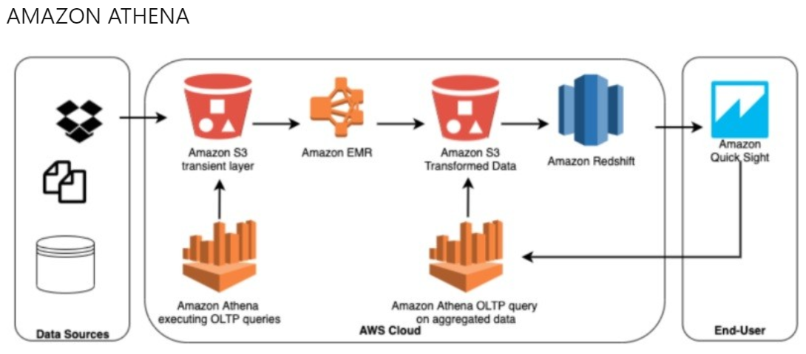
Amazon Athena is an interactive query service provided by Amazon Web Services (AWS) that allows you to analyze data stored in Amazon S3 using standard SQL queries. It is a serverless service, meaning you don't need to manage infrastructure or provision resources.

Slide 22
Amazon Athena Amazon Athena is well-suited for ad-hoc querying and exploration of large and diverse datasets stored in Amazon S3. It offers a serverless and cost-effective approach to data analysis, making it accessible to a wide range of users within an organization. Here are the key features and capabilities of Amazon Athena: Serverless Querying: With Athena, you can query data in Amazon S3 without the need for setting up and managing servers. It automatically scales resources based on the size and complexity of your queries. Standard SQL Support: Athena supports standard SQL (Structured Query Language), allowing you to use familiar SQL syntax and expressions to query and analyze your data. This makes it accessible to users with SQL knowledge and eliminates the need for learning new query languages. Schema on Read: Athena follows a schema-on-read approach, meaning that the structure and schema of the data are determined at the time of query execution. This provides flexibility in working with diverse and evolving data sets without upfront schema definitions. Integration with Amazon S3: Athena seamlessly integrates with Amazon S3, which serves as the data storage layer. You can query a wide variety of data formats in S3, including CSV, JSON, Parquet, ORC, and more. Query Performance: Athena is built on Presto, an open-source distributed SQL query engine. It automatically parallelizes and optimizes queries, providing fast and efficient results. You can also optimize query performance by partitioning data and using appropriate data formats. Cost Optimization: Athena follows a pay-per-query pricing model, where you only pay for the data scanned by your queries. There are no upfront costs or long-term commitments. You can control costs by optimizing your queries and utilizing data compression and partitioning techniques. Integration with AWS Glue: Athena integrates with AWS Glue Data Catalog, a metadata repository that stores information about data sources, tables, and partitions. This allows you to easily discover and query data without explicitly defining table schemas. Query Results and Output: Athena provides query results in standard formats like CSV, JSON, or Parquet. You can store the results in Amazon S3, stream them to other AWS services, or directly download them for further analysis or visualization.

Slide 23
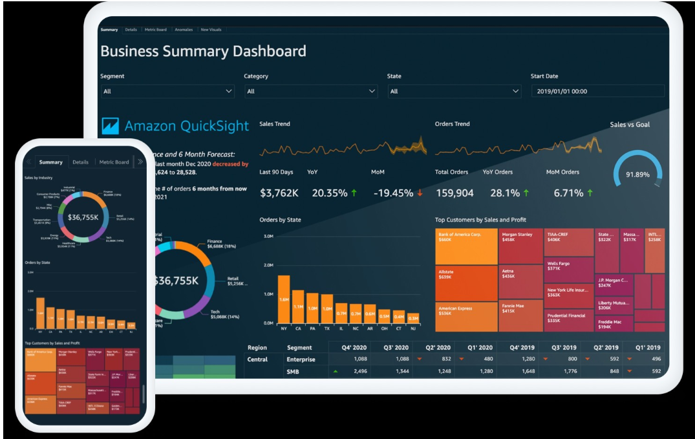
Amazon QuickSight is a fully managed business intelligence (BI) service provided by Amazon Web Services (AWS). It enables users to create interactive dashboards, perform ad-hoc analysis, and generate business insights from a wide variety of data sources.

Slide 24
Amazon QuickSight Amazon QuickSight offers a cost-effective pricing model based on a pay-per-session approach, where you only pay for the actual usage of the service. It eliminates the need for upfront infrastructure investment and scales automatically to accommodate growing data and user demands. Key features and capabilities of Amazon QuickSight include: Data Visualization: QuickSight provides a range of visualizations, such as charts, graphs, tables, and geospatial maps, to present data in a visually appealing and understandable manner. Users can customize the appearance and layout of visualizations to suit their specific needs. Data Source Connectivity: QuickSight allows you to connect to various data sources, including AWS services like Amazon Redshift, Amazon Aurora, Amazon S3, Amazon RDS, and third-party databases like MySQL, PostgreSQL, and Salesforce. It supports both cloud-based and on-premises data sources. Data Preparation and Transformation: QuickSight provides data preparation capabilities that allow users to cleanse, transform, and shape their data without the need for complex ETL (Extract, Transform, Load) processes. It offers features like data profiling, filtering, calculated fields, and data joins to prepare data for analysis. Interactive Dashboards: Users can create interactive dashboards using QuickSight's drag-and-drop interface. Dashboards can contain multiple visualizations and support drill-down, filtering, and linking between different views. Users can also add interactive controls like filters and parameters to dynamically explore data. Sharing and Collaboration: QuickSight enables users to share dashboards and analyses with others, both within and outside their organization. You can control access permissions and invite collaborators to view and interact with your visualizations. QuickSight also supports embedding dashboards in applications or websites. Machine Learning Insights: QuickSight incorporates machine learning capabilities to automatically detect trends, anomalies, and outliers in data. It can generate insights and recommendations based on the analyzed data, helping users uncover patterns and make data-driven decisions. Integration with AWS Services: QuickSight integrates with other AWS services, allowing you to leverage the full capabilities of the AWS ecosystem. For example, you can use Amazon Athena or Amazon Redshift Spectrum to analyze data stored in Amazon S3, or use AWS Identity and Access Management (IAM) for authentication and authorization. Mobile Access: QuickSight provides a mobile app that allows users to access and interact with dashboards on their mobile devices. It supports both iOS and Android platforms, enabling users to stay connected and make data-driven decisions on the go.

Slide 25
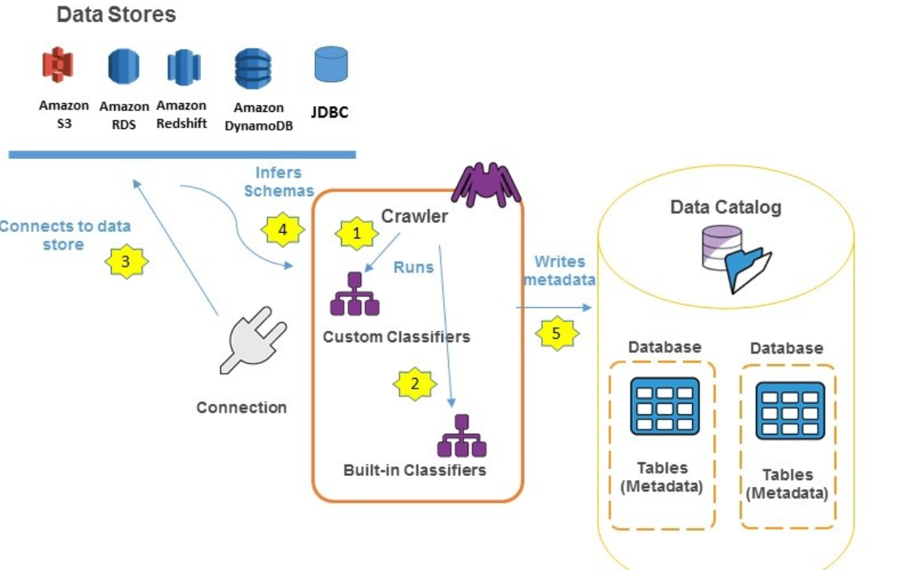
The AWS Glue Data Catalog is a fully managed metadata repository provided by Amazon Web Services (AWS). It acts as a central catalog for storing and managing metadata information about various data sources, tables, and schemas. The Data Catalog is a key component of AWS Glue and is designed to simplify data discovery, organization, and querying across different data processing and analytics services.

Slide 26
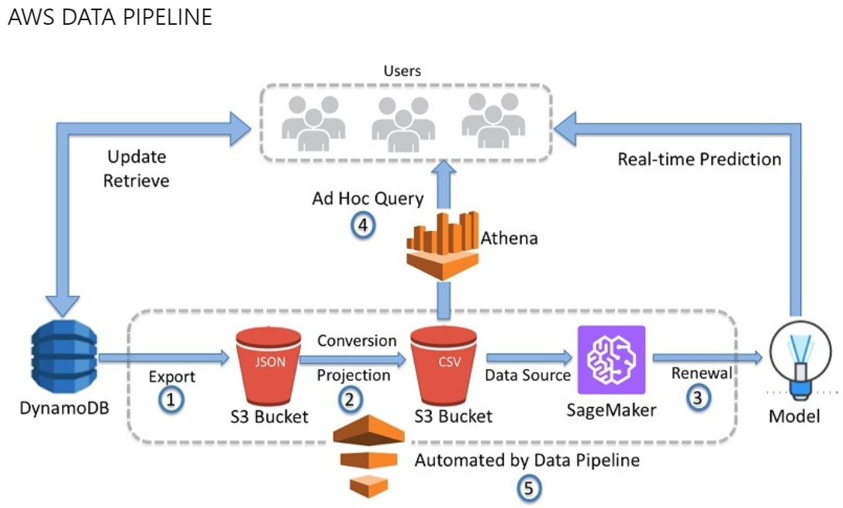
AWS Data Pipeline is a web service provided by Amazon Web Services (AWS) that allows you to orchestrate and automate the movement and transformation of data across different AWS services and on-premises data sources. It simplifies the process of building, scheduling, and managing data workflows or pipelines.

Slide 27
AWS Data Pipeline AWS Data Pipeline is a versatile service that can be used for a wide range of data integration and processing scenarios, including data migration, data warehousing, data transformation, and data analytics workflows. It simplifies the process of managing complex data pipelines and helps organizations automate and streamline their data workflows, enabling more efficient data processing and analysis. Key features and capabilities of AWS Data Pipeline include: Data Orchestration: AWS Data Pipeline enables you to define data workflows using a visual interface or programmatically using JSON-based pipeline definitions. You can specify the sequence of data processing activities, including data extraction, transformation, loading, and analytics. Workflow Scheduling: Data Pipeline provides scheduling capabilities to determine when and how often data pipelines should run. You can define time-based schedules or trigger pipelines based on events or external dependencies. Data Source Connectivity: Data Pipeline supports various data sources, including AWS services like Amazon S3, Amazon RDS, Amazon DynamoDB, and Amazon Redshift, as well as on-premises databases and other external data sources. It provides built-in connectors and adapters for seamless data integration. Data Transformation: AWS Data Pipeline offers pre-built activities and data transformation components that allow you to modify and enrich data as it moves through the pipeline. This includes filtering, aggregating, joining, and performing custom data transformations using AWS services like AWS Glue or AWS Lambda. Monitoring and Logging: Data Pipeline provides monitoring and logging capabilities to track the progress and status of data pipelines. You can view pipeline execution history, monitor data flow, and troubleshoot any issues using AWS CloudWatch Logs and other AWS monitoring services. Error Handling and Retry Mechanisms: Data Pipeline includes built-in error handling and retry mechanisms to handle temporary failures or errors during pipeline execution. You can configure retries, define error thresholds, and specify actions to take in case of pipeline failures. Security and Access Control: AWS Data Pipeline integrates with AWS Identity and Access Management (IAM), allowing you to control access to pipelines and AWS resources. You can define fine-grained permissions and roles to ensure data security and governance. Cost Optimization: Data Pipeline provides cost optimization features, such as resource allocation and release based on pipeline schedules. It allows you to manage compute resources efficiently and minimize costs associated with data processing and pipeline execution.

Slide 28
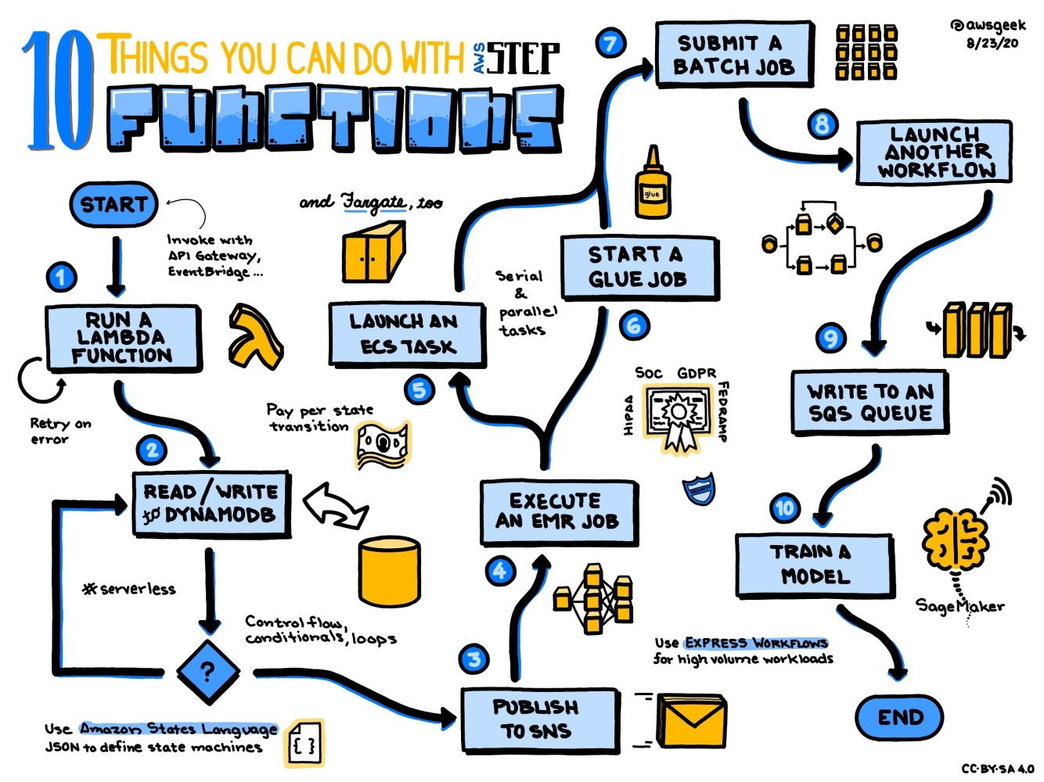
AWS Step Functions is a serverless workflow orchestration service provided by Amazon Web Services (AWS). It allows you to build, run, and coordinate distributed applications using visual workflows. Step Functions enables you to define and execute workflows as a series of steps, where each step performs a specific action or invokes a service.

Slide 29
AWS Step Functions AWS Step Functions is useful for building and coordinating complex workflows in various use cases, such as microservices orchestration, batch data processing, application workflows, and more. It provides a visual and flexible way to define and manage workflows, simplifying the development and maintenance of distributed applications. Key features and capabilities of AWS Step Functions include: Workflow Orchestration: Step Functions provides a graphical interface for designing workflows using a state machine approach. You can define the sequence of steps and conditions for transitioning between steps, creating complex workflows with conditional branching and error handling. Visual Workflow Designer: Step Functions offers a visual workflow designer that allows you to create and modify workflows using a drag-and-drop interface. You can define states, specify inputs and outputs, and configure error handling directly in the visual editor. Integration with AWS Services: Step Functions seamlessly integrates with various AWS services, such as AWS Lambda, Amazon EC2, Amazon ECS, Amazon DynamoDB, and more. You can invoke these services as steps in your workflow, enabling you to orchestrate and coordinate their execution. Retry and Error Handling: Step Functions provides built-in error handling and retry mechanisms for handling transient failures and errors during workflow execution. You can configure retries, timeouts, and error handling strategies to ensure the reliability and resiliency of your workflows. Parallel Execution: Step Functions supports parallel execution of tasks, allowing you to split your workflow into multiple branches and execute them concurrently. This enables you to optimize the performance and efficiency of your workflows by executing tasks in parallel. Human Interaction: Step Functions allows you to incorporate human interaction into your workflows by using AWS Step Functions Activities. You can pause the workflow and wait for human input or approval before proceeding to the next step. Monitoring and Logging: Step Functions provides monitoring and logging capabilities to track the progress and performance of your workflows. You can monitor execution status, view execution history, and access logs using AWS CloudWatch or integrate with other monitoring and logging services. Security and Access Control: Step Functions integrates with AWS Identity and Access Management (IAM), allowing you to control access to your workflows and resources. You can define fine-grained permissions and roles to ensure proper security and access control. Scalability and Serverless Execution: Step Functions is a serverless service, which means you don't have to manage infrastructure or worry about scaling. It automatically scales to handle the workload of your workflows, and you only pay for the actual usage of the service.

Slide 30
Other Components play important roles : AWS Snowball - Large data volumes spanning hundreds of TBs are not ideal for ingestion via network. Using this service, we will learn how to ingest mega volume data using device based offline data transport mechanism to AWS cloud. AWS Kinesis Data Firehose - One of the data ingestion mechanism is streaming. We will learn how to channel streamed data from Kinesis Data Streams to AWS Data Storage & Analytics Repositories like S3, Redshift, ElasticSearch and more using this service. AWS Kinesis Data Streams - Clients can have streaming infrastructure or even devices (IoT) which may stream data continuously. Using this service we will learn how to collect streaming data and store it on AWS.. AWS Managed Streaming for Kafka (MSK) (Nov 2018 Release) - AWS recently added Kafka to their technology stack, which has lot of similarities with Kinesis. Learn comparative features as well as the method of standing up Kafka cluster on AWS to accept streaming data in AWS. AWS Schema Conversion Tool - Database migration is a complex process and can be homogeneous (for ex. SQL Server on-premise to SQL Server on AWS) or heterogeneous ( for ex. MySQL to PostgreSQL). We will use this offline tool to learn about assessing migration complexities, generate migration assessment reports, and even perform schema migration AWS Storage Gateway - This service has striking resemblance with AWS Data Sync, and is one of the alternatives for standing cached volumes and stored volumes on AWS to build a bridge between on-premise data storage and AWS. We will briefly learn similarities between AWS Data Sync and AWS Storage Gateway. AWS ElastiCache ( Redis ) - We will learn comparative difference between Memcached and Redis for caching, and learn how to use Redis flavor of caching which can build cache clusters and can host complex data types. AWS S3 (Advanced) - AWS S3 is the basis of data storage and data lake in AWS. We will learn advanced tactics like locking data for legal compliance, cross-region global replication, data querying with S3 Select feature, Life-cycle management to move data to cold storage etc. AWS Glacier - Data keep accumulating on cloud and can increase storage costs dramatically. Infrequently used data is suitable for cold storage, where this service comes into play. We will learning archival, archive retrieval and archive querying using this service. AWS Relational Database Service (MariaDB) - We will be focusing heavily on AWS Service, which consists of 6 different types of databases. We will learn basic concepts of AWS RDS using MariaDB, stand-up an instance and query it with a client tool. AWS Relational Database Service (SQL Server) - Data needs to be imported and exported between data-centers and cloud hosted database instances. We will learn such tactics for dealing with backups and restores across cloud using SQL Server database on RDS with a client tool. AWS Internet of Things (IoT) - Today IoT is one of the fastest growing areas, and from a data perspective, its one of the most valued source of data. The first challenge enterprises phase is the mechanism of ingesting data from devices and then processing it. With prime focus on ingestion, we will learn how to solution this using an end-to-end practical example which reads data from a device and sends text messages on your cell phone. AWS ElasticSearch - ElasticSearch is one of the market leaders in search framework along with its alternative Apache Solr. AWS provides its own managed implementation of ElasticSearch, which can be used as one of the options to search data from different repositories. We will learn how to use this service for addressing search use-cases, and understand how tools like Logtash and Kibana fits in the overall solution. AWS CloudSearch - Standing up an AWS ElasticSearch needs some ElasticSearch specific understanding. For use-cases which needs a more managed solution, AWS provides an alternative packaged solution for search based on Apache Solr. We will learn how to stand up this service and use if for standing up search solutions in an express manner.

Slide 31
Implementation Roadmap defining Milestones and calendar

Slide 32
Introduction Real-life big data implementation steps may vary greatly depending on the business goals a solution is to meet, data processing specifics (e.g., real-time, batch processing, both), etc. However, from My experience, there are five universal steps that are likely to be present in most projects. Step 1. Feasibility study: Milestone 1 ( 1 Month) Analyzing business specifics and needs, validating the feasibility of a big data solution, calculating the estimated cost and ROI for the implementation project, assessing the operating costs. Step 2. Requirements engineering and big data solution planning: Milestone 2(2 Month) Defining the types of data (e.g., SaaS data, SCM records, operational data, images and video) to be collected and stored, the estimated data volume, and the required data quality metrics. ▪ Forming a high-level vision of the solution, outlining: ▪ Data processing specifics (batch, real-time, or both). ▪ Required storage capabilities (data availability, data retention period, etc.). ▪ Integrations with the existing IT infrastructure components (if applicable). ▪ The number of potential users. ▪ IOT Device sensor reading and connected over network. ▪ Security and compliance (e.g., HIPAA, PCI DSS, GDPR) requirements. ▪ Analytics processes to be introduced to the solution (e.g., data mining, ML-based predictive analytics). ▪ Choosing a deployment model: on-premises vs. cloud (public or private) vs. hybrid. ▪ Selecting an optimal technology stack. ▪ Preparing a comprehensive project plan with timeframes, required talents, and budget outlined. Step 3. Architecture design :Milestone 3(3 Month) Creating the data models that represent all data objects to be stored in big data databases, as well as associations between them, to get a clear picture of data flows, the ways data of certain formats will be collected, stored, and processed in the solution-to-be. ▪ Mapping out data quality management strategy and data security mechanisms (data encryption, user access control, redundancy, etc.). ▪ Designing the optimal big data architecture that enables data ingestion, processing, storage, and analytics.

Slide 33
Step 4. Big data solution development and testing :Milestone 4( 4 Month) ▪ Setting up the environments for development and delivery automation (CI/CD pipelines, container orchestration, etc.). ▪ Building the required big data components (e.g., ETL pipelines, a data lake, a DWH) or the entire solution using the selected techs. ▪ Implementing data security measures. ▪ Performing quality assurance in parallel with development. Conducting comprehensive testing of the big data solution, including functional, performance, security and compliance testing. Step 5. Big data solution deployment: Milestone 5( 2 Month) Preparing the target computing environment and moving the big data solution to production. ▪ Setting up the required security controls (audit logs, intrusion prevention system, etc.). ▪ Launching data ingestion from the data sources, verifying the data quality (consistency, accuracy, completeness, etc.) within the deployed solution. ▪ Running system testing to validate that the entire big data solution works as expected in the target IT infrastructure. ▪ Selecting and configuring big data solution monitoring tools, setting alerts for the issues that require immediate attention (e.g., server failures, data inconsistencies, overloaded message queue).

Slide 34
Proposed AWS data Architecture team

Slide 35
Required team: Business Analyst: Requirement gathering and Analysis Big Data Architect & Developer: Develop complete life cycle of AWS architecture plan, blueprints for data management system to integrate, centralize, protect and maintain database. Implement ETL process, orchestrate, prepare database design and dashboard . DevOps Engineer : Deployment of project and testing, troubleshoot ,Git hub ,CI\CD, Containerize, AWS Devops etc. Data Scientist: To gain the insights from refined data pipeline, dashboard and decision-making process.

Slide 36
Draft Budget for 1 year

Slide 37
Objective : Designs and builds efficient and resilient big data solutions with scalable architectures able to withstand extreme concurrency, request rates, and traffic spikes. Costs and Budget Analysis: $2 00,000 for a Ebrahim K Kanoo Group organization, depending on the project scope.

